Slide 1
fMRI signal
/preprocessing

Slide 2
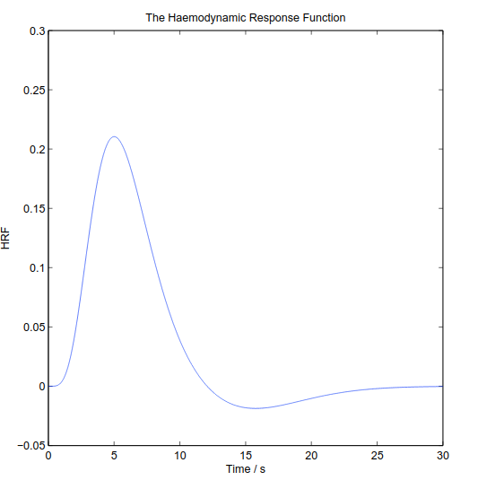
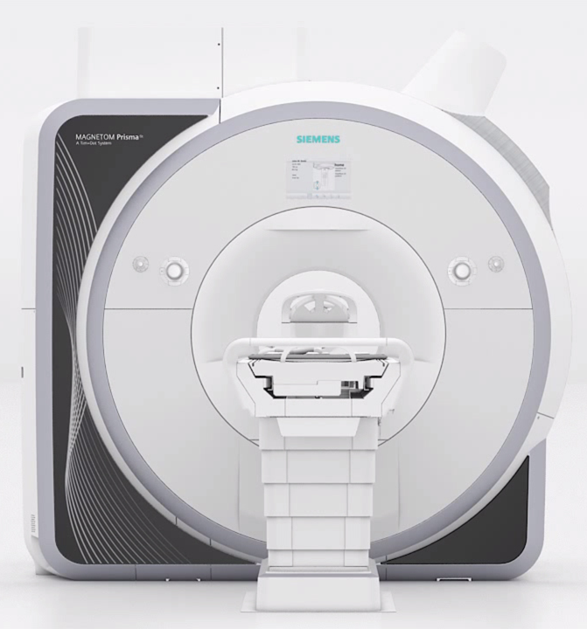
Basics of fMRI signal
MR signal: recovery of hydrogen atoms steady state following excitation.
Hemoglobin magnetic properties depends on it’s oxygenation.
The transverse relaxation (T2) is locally modified.
T2* sensitive to blood oxygenation.
Brain activity triggers a local oxygen oversupply.
This mechanism is slow and smooth: Hemodynamic Response Function (HRF).
Notes:
I am going to make a basic introduction to fMRI.
I guess some people here are already familiar with it.
I won’t dig to deep into that very large topic, or I might hit stuff I might not be able to clearly explain.
So, an MRI is an expensive machine that play with hydrogen atoms, which are widely present in our water-filled body (we all know that we are basically cucumber with emotions).
Hydrogen is an atom with a nucleus and one electron, so it is a very small magnet.
If we place it in a magnetic field, it spin will align with the field.
With coils we can transiently modify that field and see how long it takes to align back with the static field.
When it return to that steady state, it send back electromagnetic waves that we measure with antennas.
Another difference that animals have with cucumber is the blood: the hemoglobin that it contains is also a small magnet, but it’s strength depends on the oxygen attached to it.
So the oxy-hemoglobin modifies locally one of the components of the relaxation called T2, this local anomaly is called the T2 star.
So when a brain region is activated, it consumes more oxygen, so you would expect the oxygen to drop.
but in fact it triggers a massive response notably by increasing blood flow in capillaries.
This response is slow, and in a larger time scale than the neuron firing, we can see here a fit of this hemodynamic response by a combination of functions.
That’s great, we can measure brain activity but… fMRI is not that clean.

Slide 3
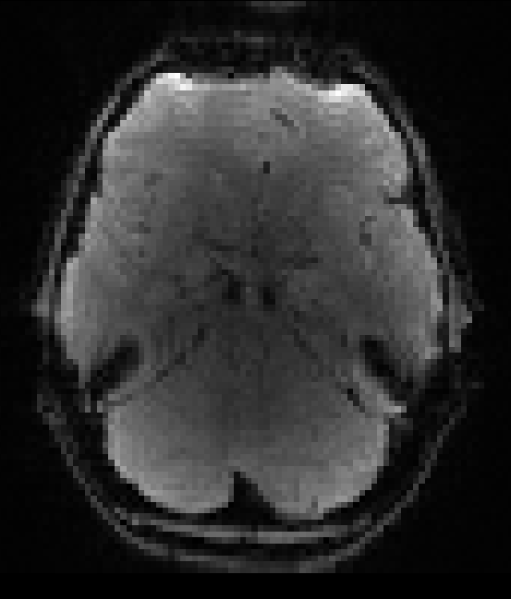
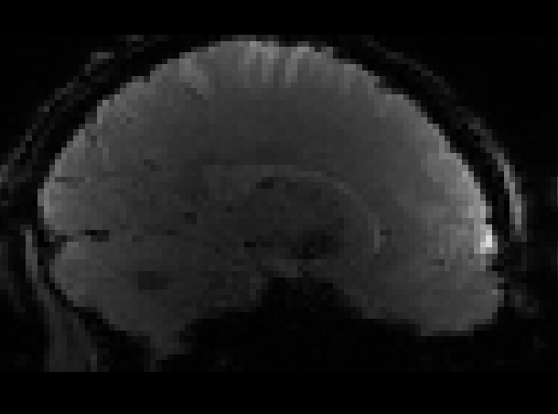
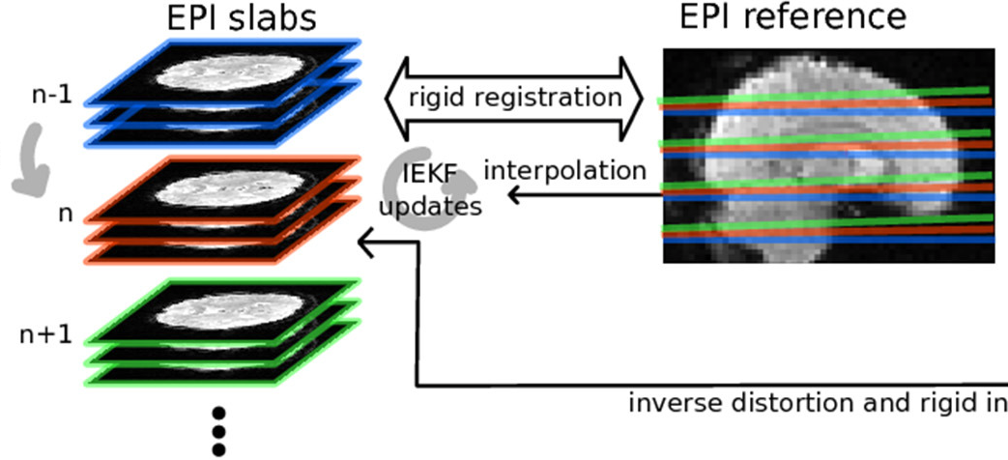
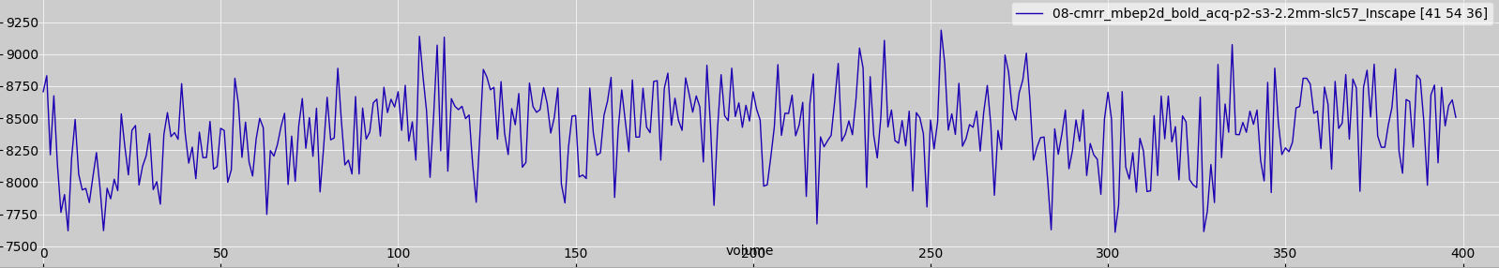
fMRI: “ugly” signal
Low-resolution (spatial and temporal).
2D slices acquired sequentially.
Blood-Oxygen-Level-Dependent (BOLD): small share of variance and not quantitative.
Motion or physiological noise cause changes in T1, T2, T2*.
Common fMRI sequences are sensitive to field inhomogeneity (distortions, signal loss).
Notes:
It is acquired at lower resolution than anatomical images, and as we measure it continuously, we acquire volume one after the other with a delay, called Time of repetition or TR.
Slices of these volumes are acquired separately, or in bunch with more recent sequences that tries to reduce the TR.
BOLD signal is not that strong, it explains about 2% of the total signal
And artefacts that spoils the fMRI have often equal or larger variance.
* The commonly used fMRI sequences are sensitive to the magnetic field inhomogeneity, and any air-tissue interface cause these inhomogeneity, the worst being the multiple interfaces in the sinuses which are the reason why this brain is squished here in the frontal lobe.
That is why we need to apply a bunch of cleaning methods before doing standard analyses, such as statistical maps or connectivity, or fancier stuff such as machine learning.

Slide 4
preprocessing
Registration (spatial)
correct motion
revert distortions
align with T1, T2...
warp T1 to template (eg. MNI)
methods: optimization of registration cost (image match) for linear/non-linear deformation.
Denoising (temporal)
slow trends
motion induced signal changes
physio (hearbeat, respiration) noise
methods:
linear regression
decomposition (PCA/ICA)
Notes:
Preprocessing usually combine a bunch of steps in a specific order.
These steps can be classified in 2 categories
Registration, which deals with align stuff so that they are spatially sound, such as correcting motion, reverting distortions, aligning between modalities, usually the T1 anatomical images, and also aligns with a template such as the MNI one to allow group analyses.
To put it simply: it takes a model of deformation (linear or non-linear) and a measure of how well it matches, and put that in a optimisation algorithm.
On the other side we have denoising, which mainly works on the temporal dimension of the data.
We remove slow trends which are mainly due to the machine heating, and motion or physiological noises.
This can be done with linear regression, or by decomposing the signal and keeping what doesn’t look to much like an artifact.
So I am done with the introduction, I will now present slides on fMRIPrep, a BidsApp pipeline that does fMRI preprocessing.

